Slide 1
Task 3
Find a vulnerability in http://testasp.vulnweb.com

Slide 2
Steps required to reproduce:
Step 1: Visit http://testasp.vulnweb.com/
Step 2: On the top menu you will find a search option.
Step 3: Click on it and you will be prompted with the Search box.
Step 4: You can intercept the request in Burp Suite
Step 5: Then send the request to intruder
Step 6: Click "clear" and select the position where you want to run your payloads and click "add"
Step 7: Then go to payloads
Step 8: Find some payloads for XSS attack and go back to payloads section and click "paste"
Step 9:Then "start attack"

Slide 3
Step 10: Then look at the request and response section
Step 11: Then select one of the request and click "see response in browser"
Step 12: If the page alerts you then the website is vulnerable to XSS attack.

Slide 4
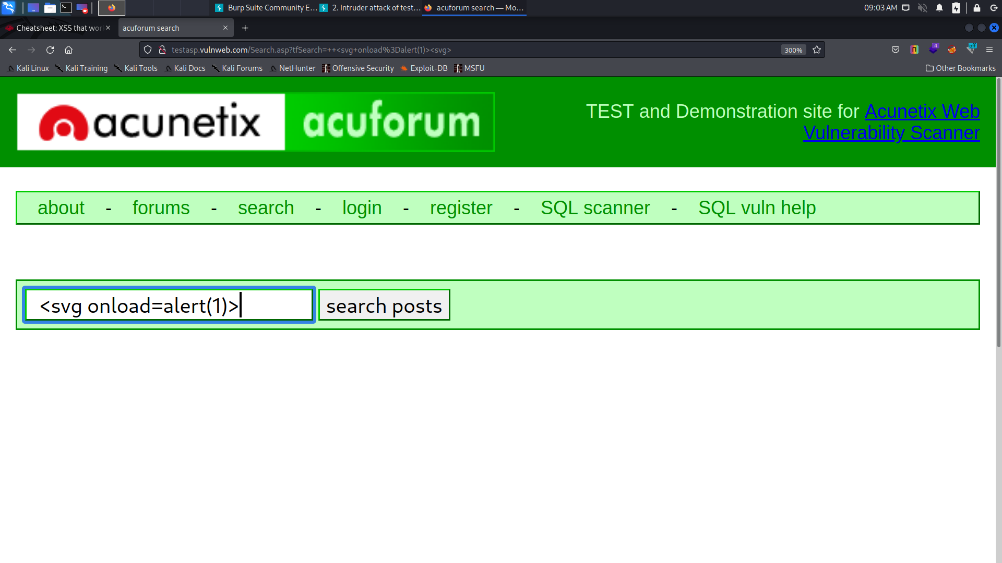

Slide 5
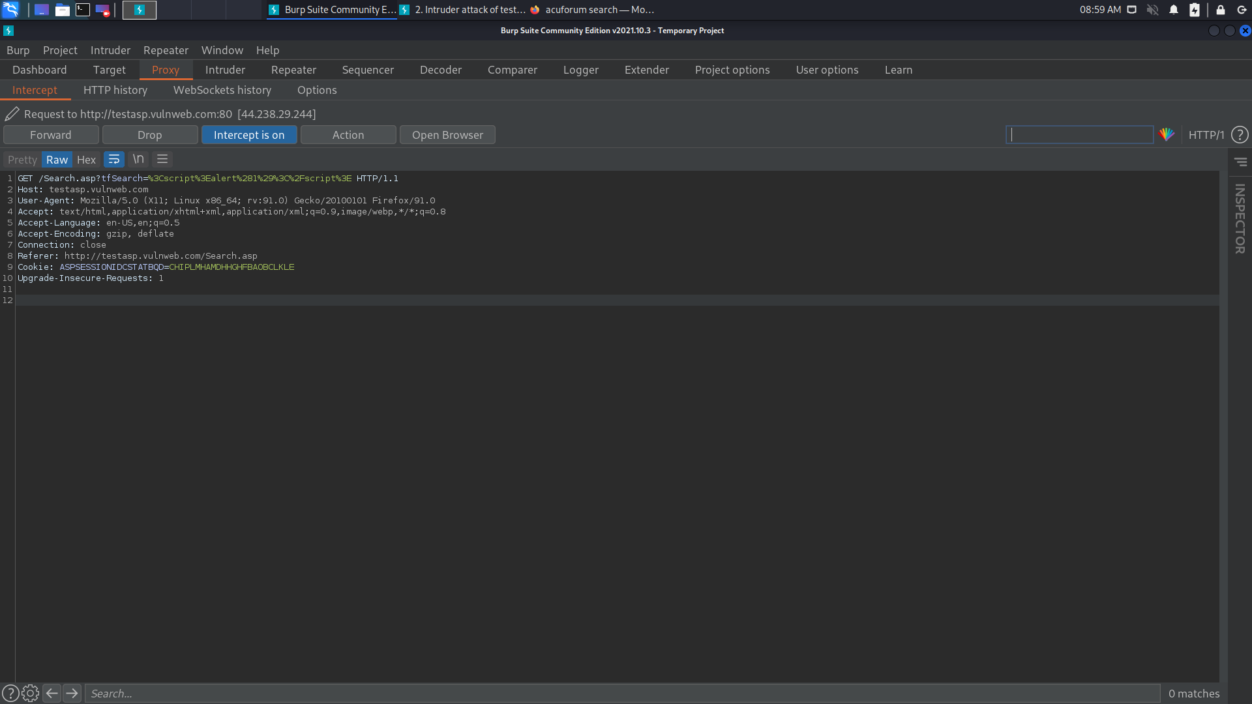

Slide 6
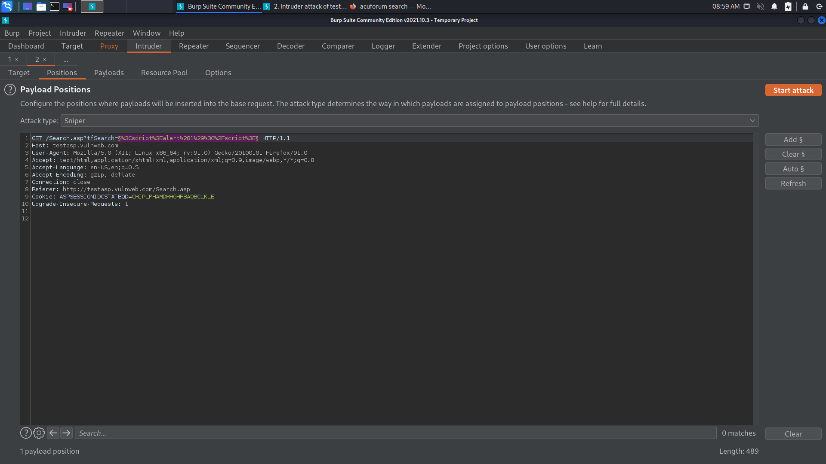

Slide 7
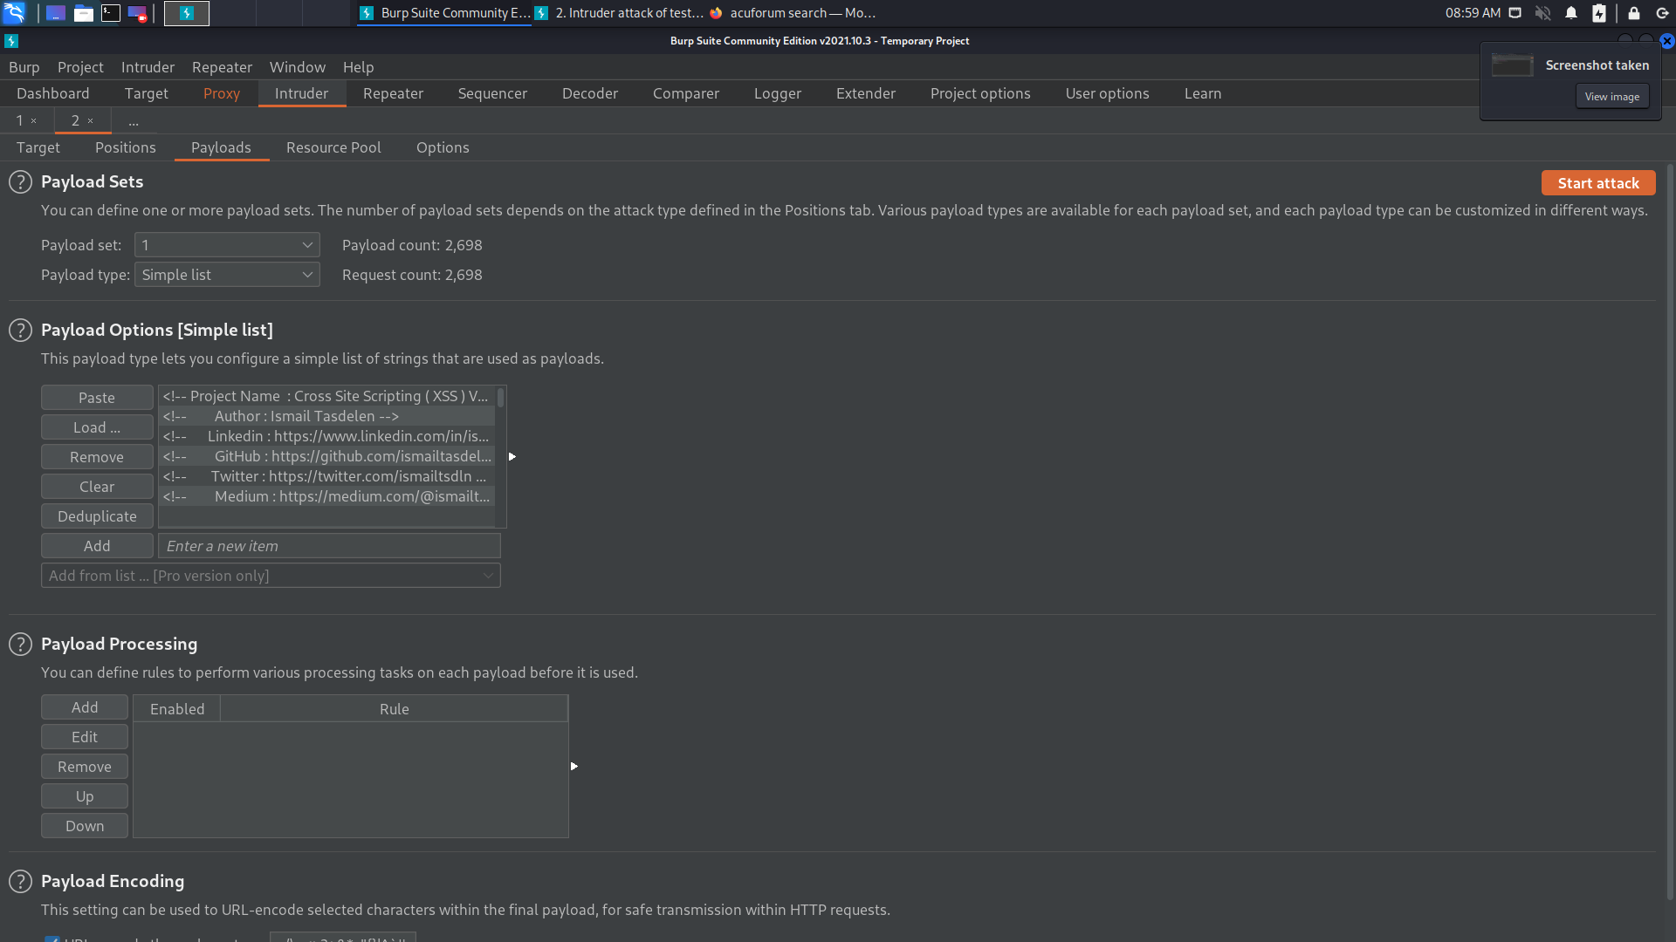

Slide 8
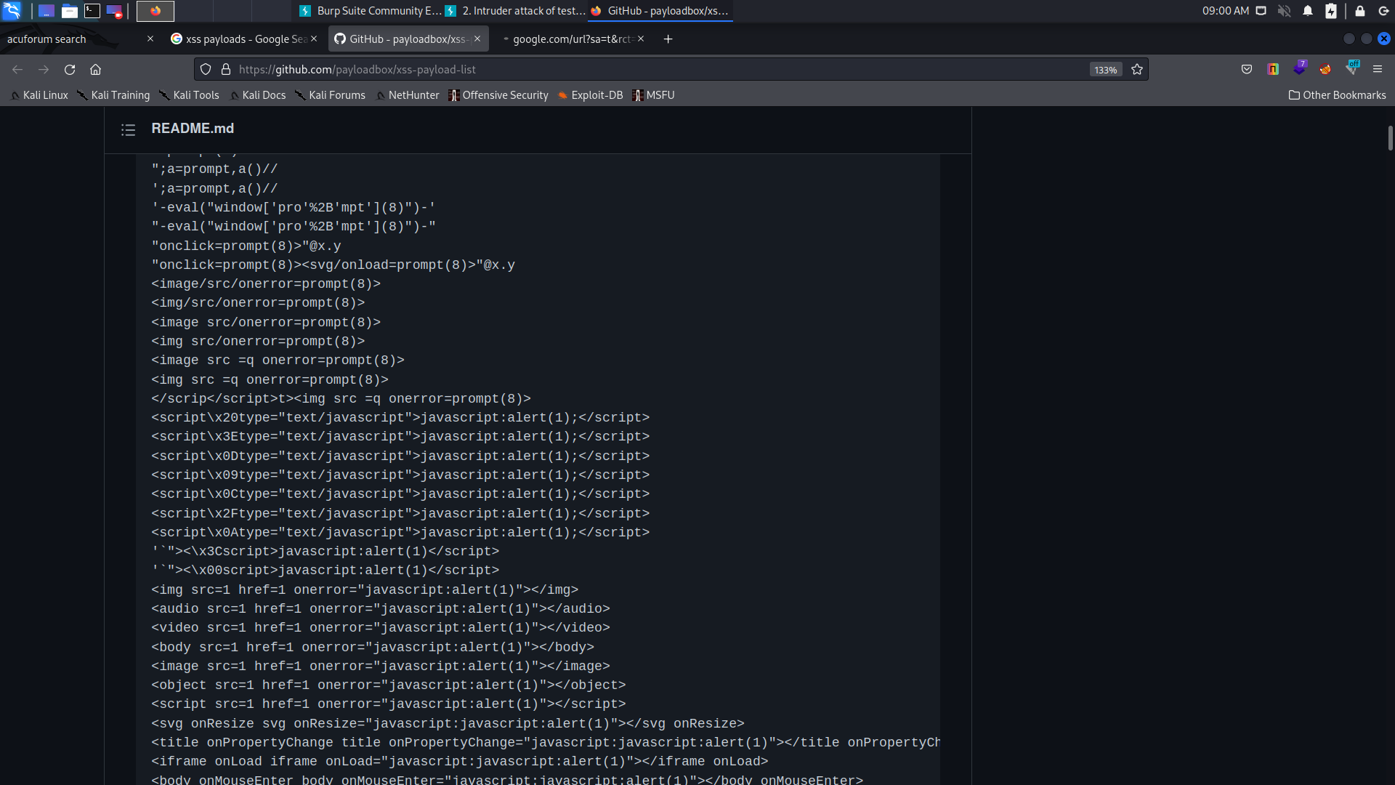
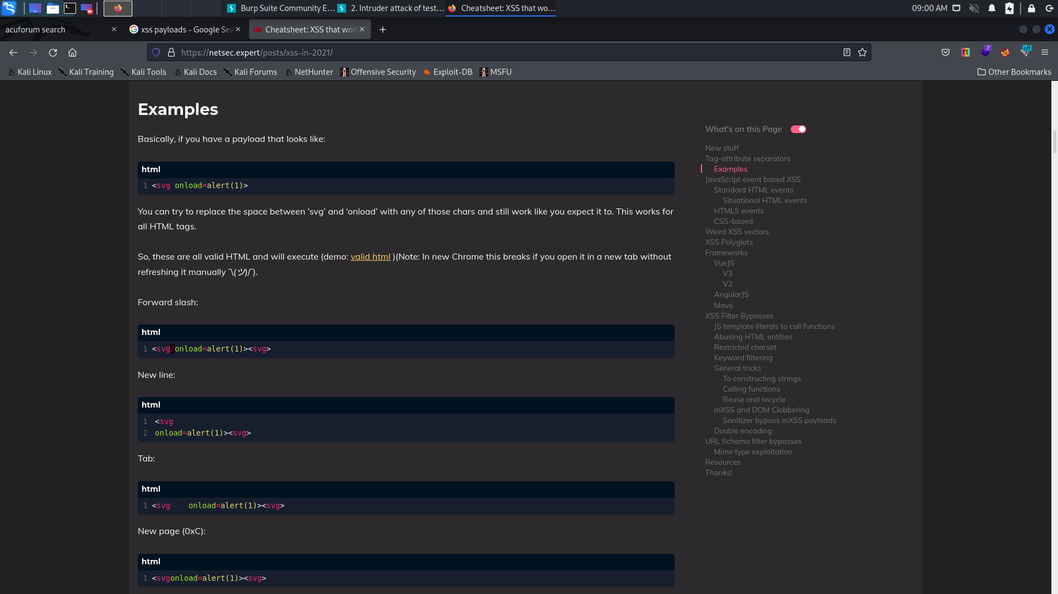

Slide 10
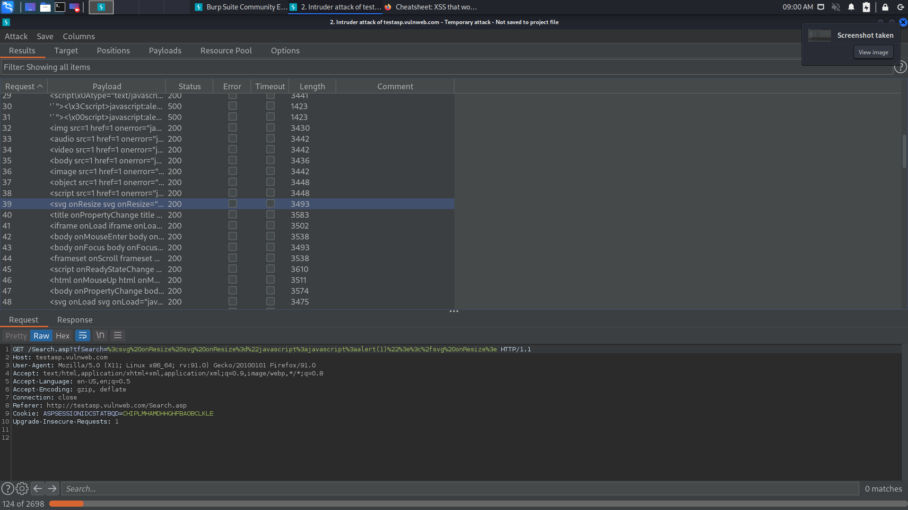

Slide 11
